Slide 1
CLEVELAND RESEARCH
AI Adoption in the Enterprise:
Technology Outpacing Applications
Cleveland AI Group
February 15, 2018
Ari Terjanian
Senior Analyst
(216) 649 7275
aterjanian@cleveland-research.com

Slide 2
Topics
AI World 2017
Where is AI being successfully deployed today?
What industries is AI expected to impact?
Enterprise considerations when building AI solutions
Bridging the divide

Slide 3

AI World 2017
2300 Attendees
Attendance up 5% vs. inaugural conference in 2016
Mix of VCs, start-ups, mature tech companies, and end users
Google, Facebook, Microsoft, iRobot, IBM, and Phillips
Also noted heavy participation from financial industry (Vanguard, Wells Fargo, Fidelity)

Slide 4
Who is Cleveland Research?
We help give clients a competitive advantage in moment of truth decisions
Focus areas: Retail, foodservice, hospitality, healthcare, tech, industrial
Channel Work
Build relationships with industry leaders >15,000 conversations per year $1-2T in spend
Customer End-markets
Equity research (asset managers) Market research Advise execs managing $2-3T in spend Advise CXO’s across industries

Slide 5
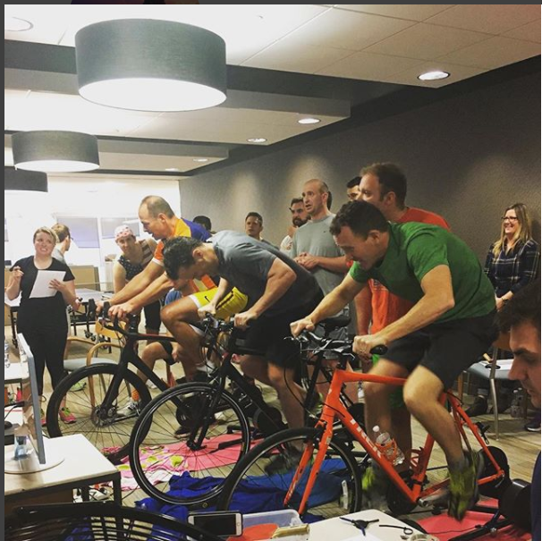
Who is Cleveland Research?

Slide 6
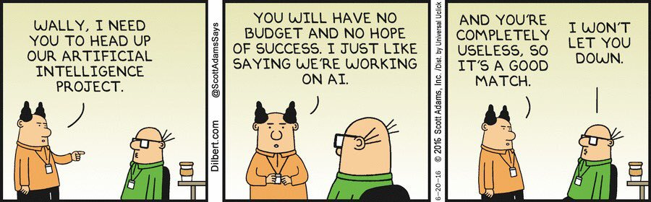
Disclaimer (i.e. what I don’t know)

Slide 7
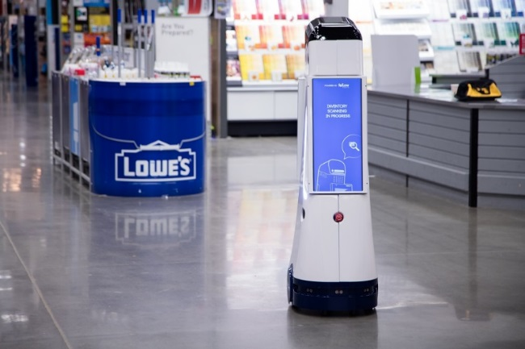
AI Adoption Today
Retail (40% of spend, 60-70% of AI apps customer facing)
Inventory
Management and replenishment (Lowe’s, Amazon)
Ecommerce
Product classification
Marketing campaigns
Highly targeted ads using data
Intelligent product recommendations
Customer support
Call center
Chat bots
Fast-food (Alexa taking our orders...)

Slide 8

AI Adoption Today
Finance
Regtech
Is what I am doing legal?
Is what I am doing compliant?
Fraud detection
Cross-over with cybersecurity
Have I been hacked? Is money being laundered?
Trading
Loan Approval

Slide 9

AI Adoption Today
Healthcare
Insurance
Customer support
What kind of insurance should I get?
Claims processing
Diagnosis
Medical history / genomic analysis
Drug development

Slide 10
Future Adopters
Logistics ($500B)
Distribution centers
Self-driving trucks
Drones
Finance ($34-$43B)
Agriculture ($25B)
Self-driving tractors
Data aggregation for precision seeding
Retail ($95B)
Energy ($140B)
Smart grid / power management
Smart cities, buildings
Healthcare ($54B)
Source: Goldman Sachs

Slide 11
Considerations When Building
Swing for singles, not home runs
Focus on specific business needs that can drive an ROI
Start small, risk little
Roll out in underpenetrated regions, test markets
Buy vs. build?
Can quickly become expensive to do in-house
Is AI a source of competitive advantage?
Ethics
Bias
Unsupervised learning
Job displacement

Slide 12
State of the Industry
VC funding
~$10B, +100% Y/Y
Panelists concerned on bubble
Current spend
~$40-$50B
Enterprise R&D
~$30-$40B
4% of enterprises claim to have AI running in production
Another 4% are in development, with 50% in testing phase (source: Gartner)
4x increase in the mention of “AI” in F500 conference calls Y/Y

Slide 13
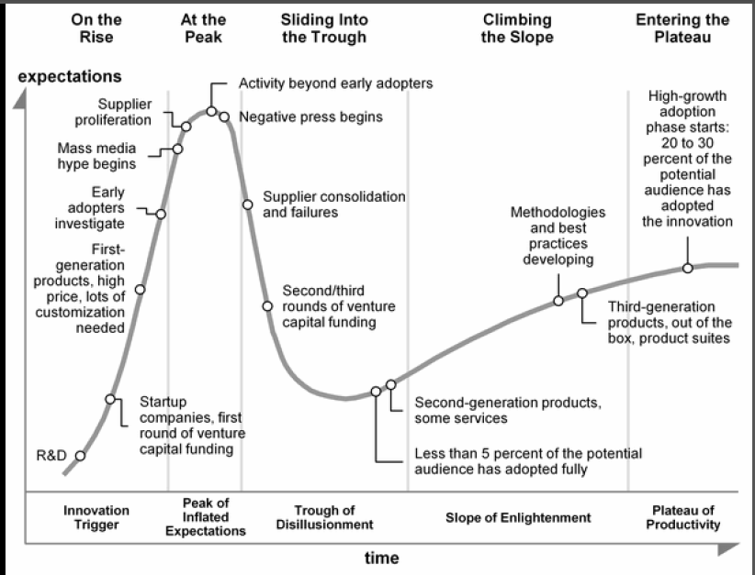
Peak of Inflated Expectations?

Slide 14
State of the Industry
Technology seen far outpacing applications
Few applications generating ROI
Algorithms viewed as commodity to certain extent
David Kiron, MIT:
“No amount of algorithmic sophistication will overcome a lack of data.”
“Even if you have the algorithms and the data, the data needs to be brought together in the right way”
“Training algorithms is a resource-intensive effort that may not deliver immediate commercial benefits”

Slide 15
State of the Industry
“No amount of algorithmic sophistication will overcome a lack of data.
Even if you have the algorithms and the data, the data needs to be brought together in the right way.
Training algorithms is a resource-intensive effort that may not deliver immediate commercial benefits.”
David Kiron, Executive Editor of MIT Sloan Management Review

Slide 16
Bridging the Gap
Grunt work needed
Data preparation and collection
Cleaning, classifying, and organizing proprietary data is a heavy lift
Can offer huge benefits
Improve the UX
Work with business users in mind
Democratize AI (Google AutoML, Microsoft Custom Speech)
Find use cases
Proprietary data + algorithm + clear application = win

Slide 17
Disclosures: We, Ari Terjanian, Benjamin J. Bollin, and Andrew Kuch certify that the views expressed in the research report(s) accurately reflect my personal views about the subject security(s). Further we certify that no part of my compensation was, is, or will be directly or indirectly related to the specific recommendations or views contained in the research report(s). The analysts responsible for the preparation of this report have no ownership stake in this company. Cleveland Research Company provides no investment banking services of any type on this or any company.
Proprietary research and Information contained herein which forms the basis for findings or opinions expressed by Cleveland Research Company may be used by Cleveland Research for other purposes in the course of compensated consulting and other services rendered to third parties. It is the policy of Cleveland Research Company to comply fully with the antitrust laws set forth by the United States Federal Government and various state laws. Our research is intended to be utilized as a resource in accordance with those established antitrust laws and regulations.
The information transmitted is intended only for the person or entity to which it is addressed. Any review, retransmission, dissemination or other use of, or taking of any action in reliance upon, this information by persons or entities other than the intended recipient is prohibited. If you received this in error, please contact the sender and delete the material from any computer. Member FINRA/SIPC

